Slide 1
Information Extraction from Legal Documents
By: Yamuna N R, Sowmya Prakash, Ahamad Shaik, Anustup Das
Supervisor : Sabine Wehnert
November 20th, 2018

Slide 2
Agenda
Problem Statement
Drawbacks of GATE
Tool Comparison
Why spaCy?
spaCy Features
Phrase Matcher for Pattern Matching
Workflow
References

Slide 3
Problem Statement
Lawyers and Enterprises face an ultimate challenge to trace large number of new legal texts or jurisdictions integrated into existing knowledge to ensure compliance. Thus, requires a context sensitive search and a grouping methodology which ensures that all relevant documents are retrieved for a specific situation[1].
Use tools for Information Extraction processes.
Overcome drawbacks of the implementation issues of tool GATE in IE process.

Slide 4
Drawbacks of GATE
The database implementation is space and time inefficient.
The visual interface is complex and somewhat non-standard.
Gate only caters for textual documents, not for multi-media documents and supports 8-bit character sets.
Module reset cascades through all previously run PRs that made nonmonotonic database updates.
Output text File is lost once GATE GUI is terminated.[3]

Slide 5
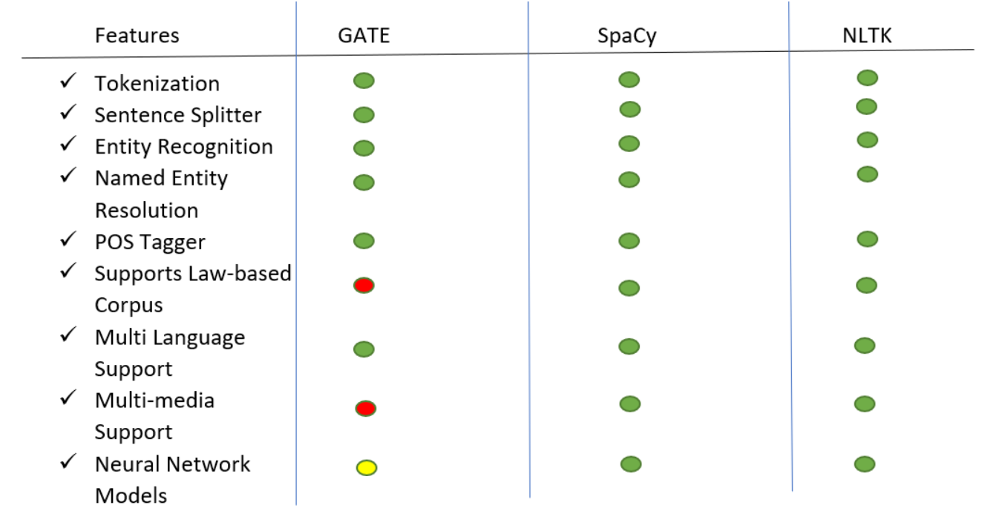
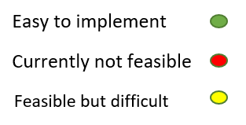
Tool Comparison[8]

Slide 6
Why Spacy?
Spacy is a free, open-source library for advanced Natural Language Processing (NLP) in Python.
Used under the Affero General Public License or through commercial license under generous terms.
Spacy by far the fastest NLP software ever released.
The full processing pipeline completes in 20ms per document which includes accurate tagging and parsing.
SpaCy's parser is faster than most taggers, and its tokenizer is fast enough for any workload.[4]
Continued…

Slide 7
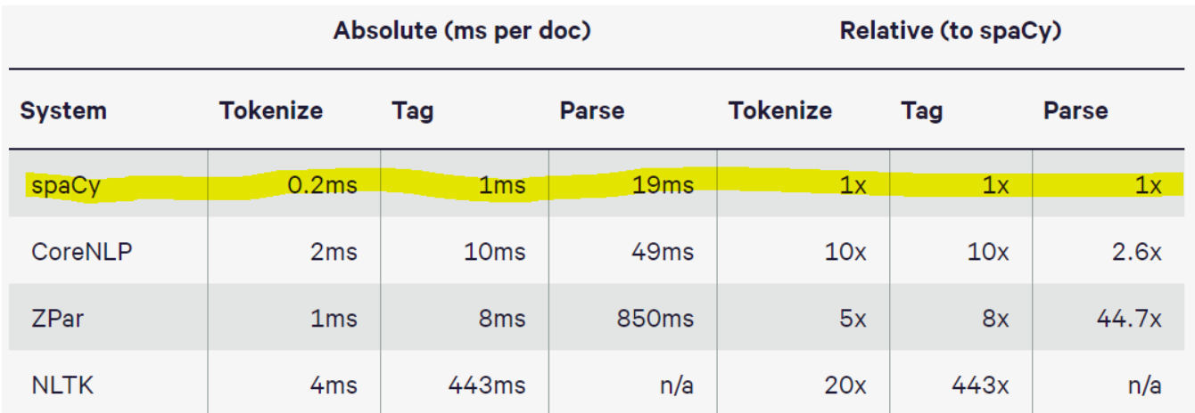
Efficiency

Slide 8
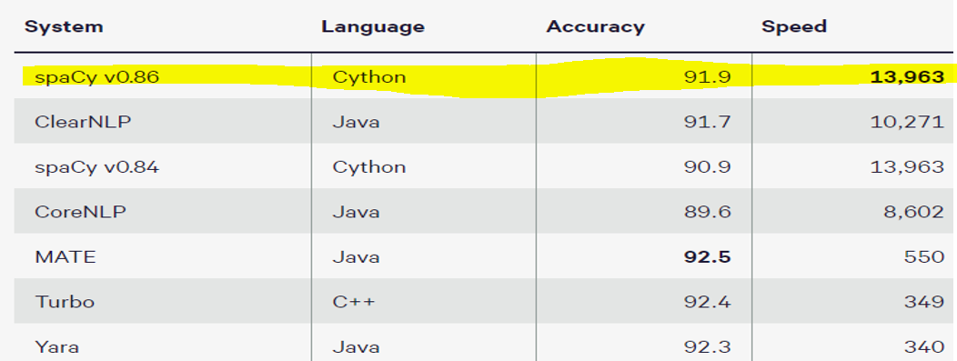
Speed Comparison
NOTE: Accuracy is % unlabeled arcs correct, speed is tokens per second.

Slide 9
spaCy Features
spaCy comes with several extensions and visualizations that are available as free, open-source libraries.
Thinc: A machine learning library optimized for CPU usage and deep learning with text input.
sense2vec: A library for computing word similarities, based on Word2vec and sense2vec.
displaCy: An open-source dependency parse tree visualizer built with JavaScript, CSS and SVG.
displaCyENT: An open-source named entity visualizer built with JavaScript and CSS.[5]

Slide 10
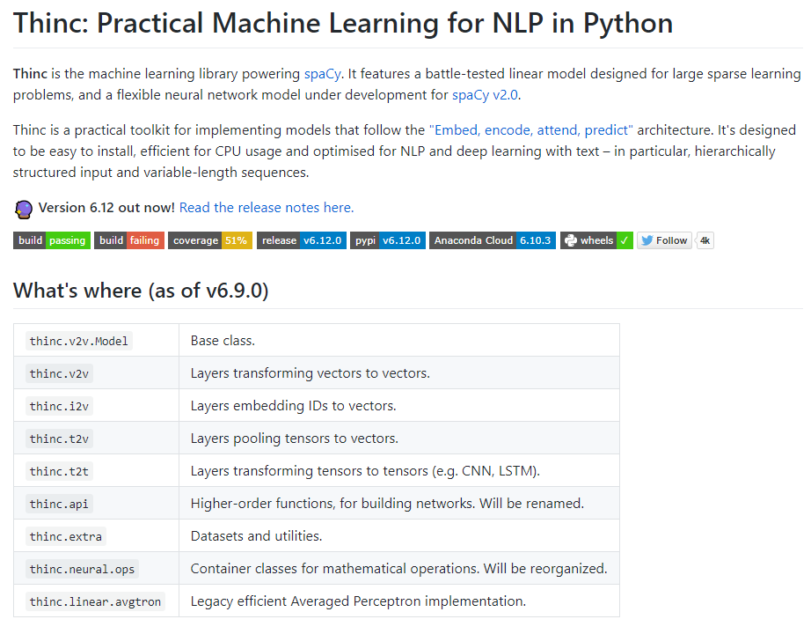
Thinc: NLP in Python[6]

Slide 11
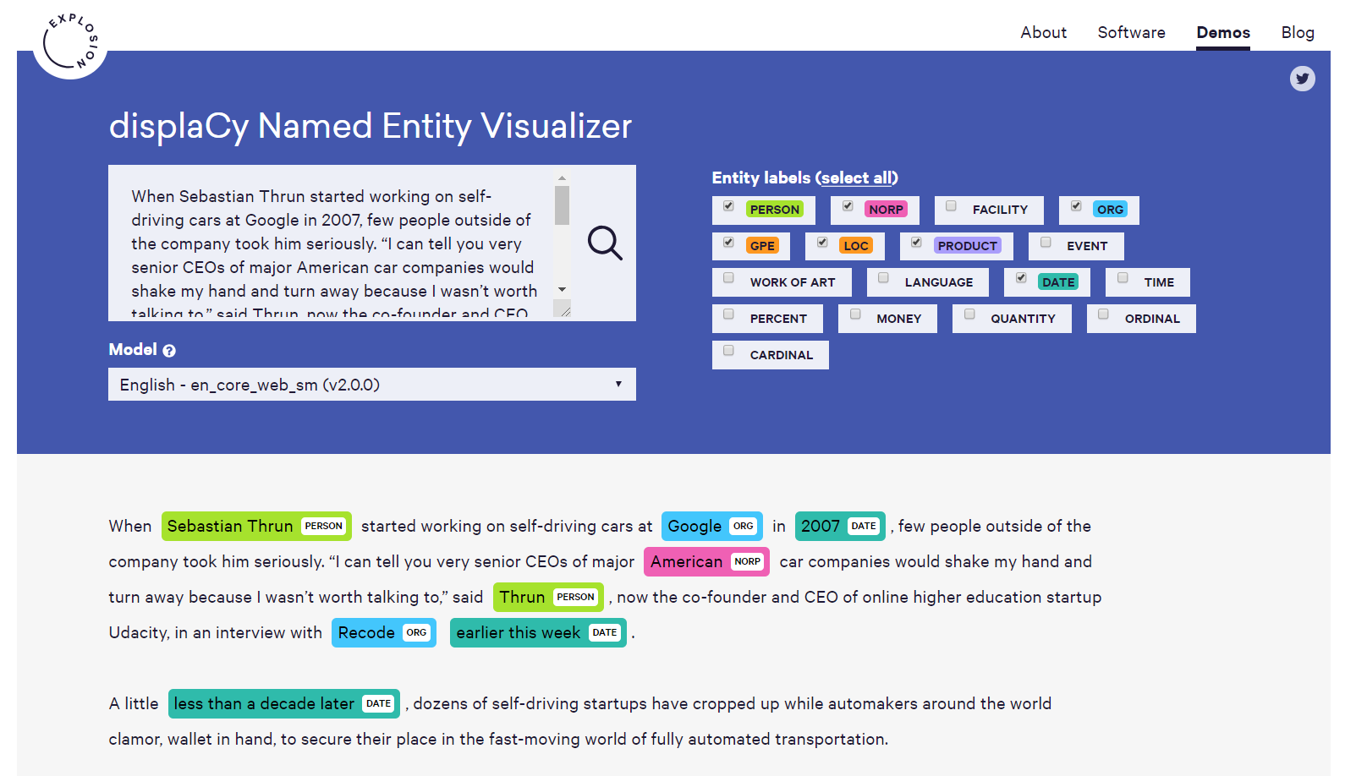

displaCy: Visualizer for spaCy

Slide 12
Phrase Matcher for Pattern Matching(spaCy) [7]
Phrase Matcher would match sequence of tokens, based on documents.
The Phrase Matcher allows efficient matching of large terminology lists. While the Matcher leads to match sequences based on lists of token descriptions,
The Phrase Matcher accepts match patterns in the form of Doc objects.
Examples:
PhraseMatcher._ _init_ _ : Create the rule-based Phrase Matcher.
PhraseMatcher._ _call_ _ : Finds all token sequences matching the supplied patterns on the Doc.
PhraseMatcher._ _add_ _ : Add a rule to the matcher, consisting of an ID key

Slide 13
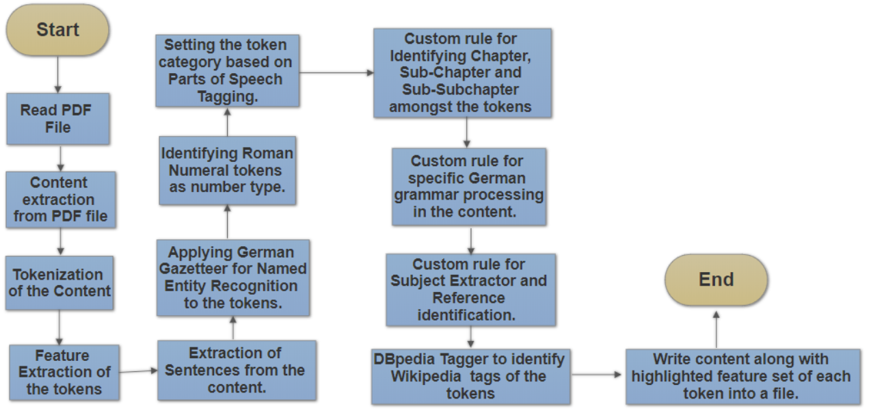
Workflow

Slide 14
References
[1] Sabine Wehnert, David Broneske, Stefan Langer, Gunter Saake(2018) Concept Hierarchy Extraction from Legal Literature. October 2018.
[2] https://gate.ac.uk/sale/lrec2012/ugc-workshop/opinion-mining-extended.pdf
[3]http://citeseerx.ist.psu.edu/viewdoc/download?doi=10.1.1.33.2691&rep=rep1&type=pdf
[4] https://www.analyticsvidhya.com/blog/2017/04/natural-language-processing-made-easy-using-spacy-%E2%80%8Bin-python/
[5] https://en.wikipedia.org/wiki/SpaCy
[6] https://explosion.ai/blog/introducing-spacy
[7] https://spacy.io/api/phrasematcher#init
[8] https://spacy.io/usage/facts-figures

Slide 15
Thank you!
12

